Slide 1
Trauma Informed Care Workshop – For Employers
Begins at 1:00 PM EST

Slide 2
Welcome
April 5, 2023
Notes:
Hello RECEs and welcome to this evening’s workshop. We appreciate you joining us tonight for a trauma-informed care workshop that has been designed specifically for RECEs.
If you would like closed caption, please click “live transcript” at the bottom of the screen. Also a reminder that this workshop is not being recorded, but everyone will receive an email, which will include the slides and a link to a feedback survey tomorrow.

Slide 3
Land Acknowledgement
3
Trauma Informed Care Workshop – April 5, 2023
Notes:
Today, spread out across the province we now call Ontario, we acknowledge that the land we are all meeting on is the traditional territory of many nations.
We begin by inviting you to reflect on the unique connections and relationships Indigenous persons and their ancestors have had with these places for thousands of years and countless generations. Traditional Indigenous knowledge has always centered on maintaining positive relationships between the human and non-human world.
Canada’s mistreatment of the original inhabitants of this land has caused immeasurable harm, not only in the past but continuing today and affecting future generations. One of the starkest examples is the cultural genocide carried out through the residential school system. That is fresh in our collective minds today as we honour the lives of children found at the sites of residential schools and the grief and strength of their families and communities. May we individually and collectively take action to support reconciliation, healing and change.
To serve and protect the public interest, we at the College must use our voices and privilege to insist upon equitable and inclusive experiences for all children that are touched by RECEs and to amplify the voices of those with lived experiences of being marginalized. We owe those responsibilities to the Indigenous caretakers of this land who continue to suffer the effects of colonialism.
OCRCC’s land acknowledgment
I acknowledge that the land we are on today, from anywhere on Turtle Island is stolen land. Tkaronto, where I am working from, is the traditional territory of many nations, including the Mississauga of the Credit, the Anishnabee, the Chippewa, the
Haudenosaunee, and the Wendat, and home to many diverse First Nations, Inuit, and Metis peoples.
KSAC in downtown Kenora is located on Treaty 3 territory and the land on which we gather is the traditional territory of Ojibway/Chippewa. We are on original lands of Anishinaabeg, Cree, Oji-Cree, Dakota and Dene peoples, and on the homeland of the Métis Nation.
Our cities are built on sacred land covered by the Dish With One Spoon Wampum Belt Covenant, an agreement to share and care for the resources around the Great Lakes. We believe that it is our inherent responsibility to honour the knowledge, resilience, and claims to sovereignty of the First Peoples of this land. We are deeply committed to doing the self-work that is necessary to understand how we can contribute directly to the decolonizing of White supremacist settler colonial systems and institutions, both as individuals and as an organization.

Slide 4
Reason for this session
The Sexual Abuse Prevention Program is an educational requirement for all RECEs
Offer ways you can support the RECEs in your setting with completing the prevention program
Help in understanding any reactions that you or others might have when engaging with the prevention program content
4
Trauma Informed Care Workshop – April 5, 2023
Notes:
I’d like to emphasize here that this workshop is NOT the Sexual Abuse Prevention Program. These workshops are being offered to support RECEs with completing the Sexual Abuse Prevention Program.
You will not receive a certificate for this workshop.

Slide 5
What’s the Sexual Abuse Prevention Program?
Three required elements
Commit to Kids
Teatree Tells
College resources to review:
Professional Advisory: Duty to Report
Racism and Bias in Reporting to Child Welfare
Scenarios
5
Trauma Informed Care Workshop – April 5, 2023
Notes:
The Sexual Abuse Prevention Program supports our members’ commitment to the personal safety, health, and well-being of all children and empowers them with proactive approaches to help prevent child sexual abuse. While this subject matter can be challenging, the program includes resources to support members, so they can expand their understanding of child sexual abuse, how to recognize behaviours of concern and learn prevention strategies. Enhancing the ability of Ontario’s more than 58,000 RECEs to prevent sexual abuse of children will have an immediate and significant impact on the safety and healthy development of hundreds of thousands of children.
The College developed the program in partnership with the Canadian Centre for Child Protection, a national charity dedicated to the personal safety of all children.
The organization’s goals are to:
reduce the sexual abuse and exploitation of children
assist in the location of missing children, and
prevent child victimization through programs, services, and resources for Canadian families, educators, child-serving organizations, law enforcement, and other parties.
The first 2 required elements, commit to Kids and Teatree tells, were developed by the College’s online education partner, the Canadian Center for Child Protection.
The third required element is College resources to review: They provide information related to child sexual abuse and responsibilities specific to the practice of early childhood education in Ontario.

Slide 6
Supporting Members with the Sexual Abuse Prevention Program
Program available July 2022
Access via My College Account
Member Support
Instructions for Completing the Sexual Abuse Prevention Program and Confirming Compliance
Caring for Self and Others
This trauma-informed care workshop​ for members
People Connect mental health resource
6
Trauma Informed Care Workshop – April 5, 2023
Notes:
The SAPP is accessed through my College Account.
You can also use my College Account o see when to start and other details specifically for you.
Member Support
New - The College has been working on initiatives that support the mental health of our members. We hope that many of you have already seen the eblast announcement about People Connect, which is now available to all members.
People Connect is an online mental health resource centre that includes: a self-assessment tool to help recognize and understand symptoms of mental health conditions; access to virtual mental health therapy; and information and a resource library for credible mental health information. RECEs can access People Connect at no cost, as the platform and its services are sponsored by the College for the benefit of our members.
For more details, and a link to our People Connect platform, please take a look at our website.

Slide 7
Introductions
Hillary Di Menna (she/her)
Jessica Wang (she/her)
Mitzi Beth Webb (she/her)
7
Trauma Informed Care Workshop – April 5, 2023
Notes:
Hillary Di Menna (she/her) is a gender justice advocate, writer, and public educator. In addition to her work with the Ontario Coalition of Rape Crisis Centres, she has worked for various sexual assault centres, York University's 'The Centre for Sexual Violence Response, Support & Education,' and in grassroots feminist organizing. Hillary has her MA in Gender, Feminist & Women's Studies from York University.
Jessica Wang (she/her) is a public educator and program manager for the anti-human trafficking program for the Niagara Sexual Assault Centre. She has worked at the Centre for the past 4 years in various capacities as she started as a crisis line volunteer. She has worked both in secondary and elementary schools delivering programs such as human trafficking prevention and sexual assault awareness across the Niagara region. Currently she is managing an anti-sex trafficking training program for the hospitality industry along with a 24/7 text/talk line for sex trafficking survivors. Jessica has just completed her B.A in Psychology.
Mitzi Beth Webb (she/her) is a sexual assault therapist with Muskoka Parry Sound Sexual Assault Services. She recently completed her master’s in Social Work at Lakehead University. Mitzi Beth has worked in the field of gender-based violence in various capacities, including front-line work in shelters and transition houses as well as feminist research, advocacy, and public education.

Slide 8
Today’s Workshop
Defining Sexual Violence & Consent
Trauma-Informed Care
Disclosures
Trauma Responses
Processing Triggers & Self-Care
Q+A period
8
Trauma Informed Care Workshop – April 5, 2023
Notes:
Hillary
We will be discussing, and laying the groundwork for future discussions around:
● Defining sexual violence + Consent
● Disclosures
● Trauma-informed care
● Trauma responses
● Processing triggers
● Q+A period - we’ll have dedicated times for discussion, I’ll have Krista monitoring the chat for any questions that come in.
This material is meant to be foundational and introductory; in order to facilitate further discussion, encourage questions, and help inform the important work that you do. There will be time set aside for questions and discussion.

Slide 9
Support
Talking about sexual violence isn't easy.
If you find you are in need of support, please message our counsellor directly in the chat.
A space will be created to maintain confidentiality.
An online directory of sexual assault centres across Ontario can be found at sexualassaultsupport.ca/support
9
Trauma Informed Care Workshop – April 5, 2023
Notes:
Hillary
We have a counsellor from Sexual Assault Centre Quinte & District with us today. I’ll have Heather pop on for a sec so you can recognize her. If in need of support, please message Heather, directly in the chat, and she can set up a breakout room. Your name will only appear to Heather and today’s meeting hosts, but it will only be Heather in the breakout room with you, and what is shared in that space will be confidential and kept between you both.
● Name change to maintain anonymity
● Cameras off - they can come back on during the scheduled Q+A sessions
An online directory of sexual assault centres across Ontario can be found at sexualassaultsupport.ca/support (which we will put in the chat now and again at the end of the workshop)

Slide 10
Ontario Coalition of Rape Crisis Centres (OCRCC)
network representing over 30 English-speaking sexual assault centres across Ontario
advocates for the needs of survivors of sexual violence across the province
partner with allies to share information about sexual violence and its root causes
Niagara Sexual Assault Centre (NSAC)
responds to the needs of survivors of sexual violence and through public education increases understanding and awareness
provides a variety of counselling, support and emergency services to survivors and their families
uses a feminist, empowerment approach and holds the universal truth that all clients are treated with respect and dignity.
10
Trauma Informed Care Workshop – April 5, 2023
Notes:
Ontario Coalition of Rape Crisis Centres (OCRCC): Established in 1977, the OCRCC is a network representing over 30 English-speaking sexual assault centres across Ontario.
The OCRCC advocates for the needs of survivors of sexual violence across the province to government and other other regional, provincial and national groups, engaging in policy work, and speaking to the media about sexual violence myths and
misconceptions, the facts about reporting and conviction rates in Canada, and the needs of survivors in local communities. We partner with allies to share information about sexual violence and its root causes, participate in public education on sexual violence, and facilitate communication between sexual assault centres.
KSAC is a non profit organization in the heart of Kenora dedicated to serving our community affected by sexual assault, human trafficking and domestic violence.
The Kenora Sexual Assault Centre (KSAC) provides twenty-four hour (24) crisis intervention, emergency transportation, personal support, advocacy, practical assistance and safety planning (e.g. meals, transportation and emergency accommodation) to female victims/survivors of sexual assault in the Kenora District.
KSAC operates a 24 hour local, and toll-free, crisis and support line. KSAC provides counselling, advocacy, support and information to female victims/survivors at the hospital and during police/court proceedings. KSAC also provides follow-up care, such as one-to-one and group counselling as well as referrals and accompaniment to related community services (e.g. housing, social assistance, child and family services) for female survivors of sexual assault in the Treaty #3 area.
In essence, KSAC provides both short and long term support and services to female victims/survivors of sexual violence, depending on their individual needs. KSAC offers ongoing support in all aspects of the healing and empowerment process. This includes the support services offered via KSAC’s 24 hour crisis line.

Slide 11
Defining Sexual Violence & Consent

Slide 12
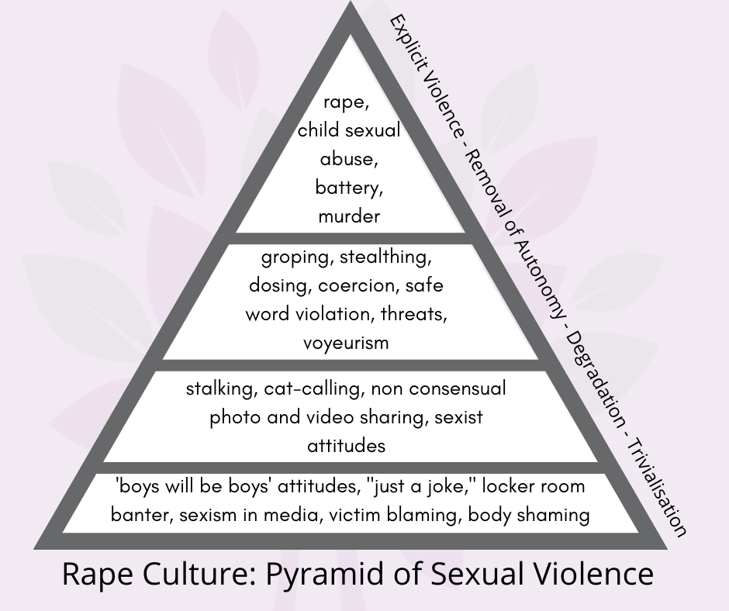
Defining sexual violence
12
Trauma Informed Care Workshop – April 5, 2023
Notes:
We just shared legal definitions, but it is important to challenge any fixed ideas we have around sexual violence and to recognize that it can be a spectrum. This way we can recognize, and challenge, the different ways sexual violence exists.
As shown in this graphic here, sexual violence can be acts of
● Trivialisation - such as locker room banter, sexist media, body shaming, victim blaming, “boys will be boys” narrative, and locker room talk
● Degradation - stalking, cat-calling, non-consensual photos and video being recorded and/or being shared, sexist attitudes
● Removal of autonomy - groping, stealthing, dosing, coercion, safe word violation, threats, voyeurism
● Explicit violence - rape, incest, battery, murder
These are examples and not an exhaustive definition, nor are these levels completely removed from each other, as they are all operating pieces of creating and maintaining rape culture.

Slide 13
Stats on sexual violence
Young women from excluded groups are more vulnerable to being targeted for sexual harassment and sexual assault. This includes women of colour, disabled women, intersex, queer, trans, and Two Spirit folks, and women experiencing multiple intersections of identity.
In children and youth, 1 in 7 girls reported that another student has sexually assaulted them.
15% of girls and 9% of boys between the ages of 14 to 21 identified that they have had a sexual act forced upon them by a peer.
There are 636,000 sexual assaults self-reported every year in Canada.
Being under 12 years old heightens vulnerability to being targeted for sexual offences
Young women between the ages of 15 and 25 years, in Canada, are the age group most likely to experience sexual or relationship violence
13
Trauma Informed Care Workshop – April 5, 2023
Notes:
● There are 636,000 sexual assaults self-reported every year in Canada.
● being under 12 years old heightens vulnerability to being targeted for sexual offences
● Young women between the ages of 15 and 25 years, in Canada, are the age group most likely to experience sexual or relationship violence
● Young women from excluded groups are more vulnerable to being targeted for sexual harassment and sexual assault. This includes women of colour, disabled women, intersex, queer, trans, and Two Spirit folks, and women experiencing multiple intersections of identity.
● In children and youth, 1 in 7 girls reported that another student has sexually assaulted them.
● 15% of girls and 9% of boys between the ages of 14 to 21 identified that they have had a sexual act forced upon them by a peer.
References: https://www150.statcan.gc.ca/n1/pub/85-002-x/2017001/article/14842-eng.htm;
https://www.cbc.ca/news/canada/marketplace-school-violence-sexual-violence-1.5329520;

Slide 14
Consent FRIES
14
Trauma Informed Care Workshop – April 5, 2023
Notes:
This is the Planned Parenthood FRIES graphic. This acronym is an easy way to remember what consent looks like:
Freely given - Without coercion, Without blackmail, Without guilt tripping, Without pressure or influence, Given on a voluntary basis
Reversible - Consent is ongoing, Consent can be withdrawn at any time
Informed - All parties know exactly what they are consenting to
Enthusiastic - Not simply a “yes” but an enthusiastic yes, Verbally and through body language
Specific: consent to one act is not consent to another, As with informed, all parties know what they are consenting to, Consent to one act is not consent to another
References: Planned Parenthood,
www.plannedparenthood.org/learn/relationships/sexual-consent

Slide 15
Consent
Consent cannot be present when:
Someone says or does something that shows they are not consenting to an activity
Someone says or does something that shows they are not agreeing to continue an activity
Someone is incapable of consenting (e.g., unconscious or incapacitated)
Presence of coercion as a result of abuse of trust, power, or authority
Someone else consents on the person’s behalf
15
Trauma Informed Care Workshop – April 5, 2023
Notes:
The topic of consent is covered in the Sexual Abuse Prevention Program, however…
In order to better understand trauma-informed care, we’re going to take a few moments to discuss what consent means and looks like.
Consent cannot be present when:
● Someone says or does something that shows they are not consenting to an activity
● Someone says or does something that shows they are not agreeing to continue an activity
● Someone is incapable of consenting (e.g. unconscious,incapacitated, drunk, or high)
● Presence of coercion as a result of abuse of trust, power, or authority
● Someone else consents on the person’s behalf
References: Canada Justice Laws, laws-lois.justice.gc.ca; LEAF: Women’s Legal Education & Action Fund, www.leaf.ca/news/the-law-of-consent-in-sexual-assault

Slide 16
Consent
A person cannot say they mistakenly believed consent was present if:
That belief is based in their own intoxication
They were reckless in ensuring consent was present
They ignored verbal or behavioral signs that would indicate lack of consent
The person was silent/did not verbally indicate “no”
16
Trauma Informed Care Workshop – April 5, 2023
Notes:
A person cannot say they mistakenly believed consent was present if:
● That belief is based in their own intoxication
● They were reckless in ensuring consent was present
● They ignored verbal or behavioural signs that would indicate lack of consent
● The person was silent/did not verbally indicate “no”
References: LEAF: Women’s Legal Education & Action Fund,
www.leaf.ca/news/the-law-of-consent-in-sexual-assault

Slide 17
Consent isn’t just about sexual situations. Consent is an essential part of our everyday life, in everything that we do.
17
Trauma Informed Care Workshop – April 5, 2023
Notes:
Consent isn’t just about sexual situations. Consent is an essential part of our everyday life, in everything that we do.

Slide 18
Trauma-Informed Care

Slide 19
Types of Trauma
Acute trauma: results from a single stressful or dangerous event.
Chronic trauma: results from repeated and prolonged exposure to highly stressful events.
Complex trauma: results from exposure to multiple traumatic events.
sexualassaultsupport.ca
19
Trauma Informed Care Workshop – April 5, 2023

Slide 20
Trauma Informed Care
Trauma informed care recognizes trauma symptoms and acknowledges the role trauma can play in a person’s life, with an understanding that no two survivors will react the same way, if similarly, at all.
sexualassaultsupport.ca
20
Trauma Informed Care Workshop – April 5, 2023

Slide 21
Trauma Informed Support
Trauma informed support…
Should reduce risk
Promote resilience
Aid recovery by increasing safety and well-being
Acknowledges the importance of building trust
21
Trauma Informed Care Workshop – April 5, 2023
Notes:
Support carried out during a time of crisis
should reduce risk
promote resilience
aid recovery by increasing safety and well-being
Acknowledges the importance of building trust
Trust building will let the survivor know that you are a safe resource.
The more comfortable a survivor is speaking with you, the more you can help in determining appropriate support systems and processes.
You can say all the right things, use all the right words, but without comfort and a sense of safety, there is no trust.
References: Guidance for conducting trauma-and violence informed programs during a pandemic, natural disaster, crisis, or other emergency situation, Western University,
kh-cdc.ca/en/resources/guides/guide1/Knowledge-Hub-Guide-Programs.pdf

Slide 22
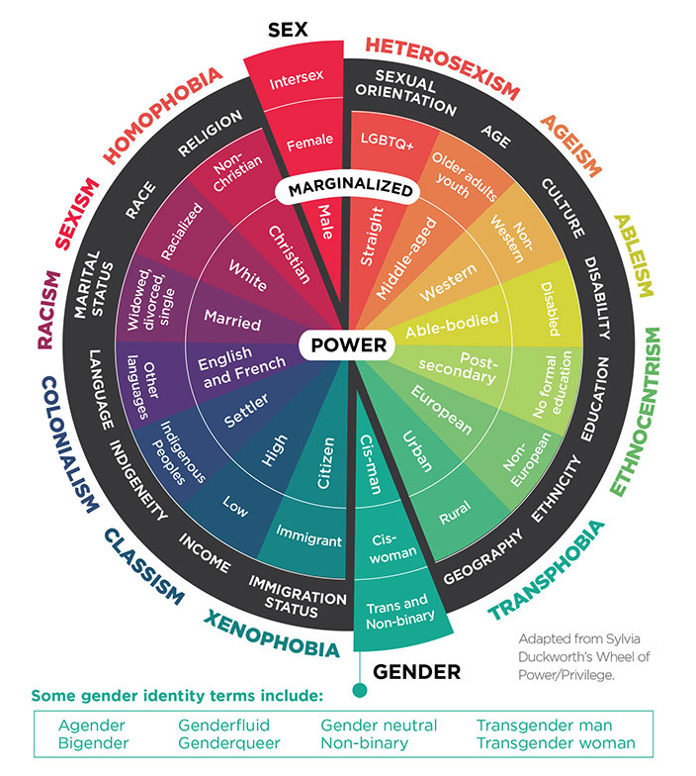
Trauma Informed Care: intersecting identities
How people experience, heal from and address sexual violence is shaped by age, gender, race, ability, class, and other social locations.
22
Trauma Informed Care Workshop – April 5, 2023
Notes:
How people experience, heal from and address sexual violence is shaped by age, gender, race, ability, class, and other social locations.
This chart helps us look at different intersections of a person’s life, including our own, to better understand different life experiences and different power dynamics. *
*Use chart to guide the following:*
Gender and race has concrete impacts on one’s experience of sexual violence. Canadian studies note that young women from marginalized racial, sexual, and socioeconomic groups are more vulnerable to being targeted for sexual harassment and sexual assault
Indigenous women are more than three times more likely to experience violence than nonIndigenous women
Women with disabilities are four times more likely to experience sexual violence than women without disabilities.
Image: Meet the Methods series: Quantitative intersectional study design and primary data collection, Greta Bauer, Ph.D, cihr-irsc.gc.ca/e/52352.html
References: Wolfe and Chioda, as quoted in Safe Schools Action Team Report on Gender-based Violence, Homophobia, Sexual Harassment & Inappropriate Sexual Behavior in Schools. 2008.
Shaping a Culture of respect in our Schools: Promoting Safe and Healthy; Native Women’s Association of Canada; DAWN Canada

Slide 23
Trauma Informed Care how identity, power, privilege shapes what support can look like
The Canadian criminal justice system
is rooted in colonialism; we need to acknowledge the inherent system of power and oppression
does not address root causes of sexual violence and it does not, in most cases, bring the support piece a survivor needs
few survivors report the violence they experienced
23
Trauma Informed Care Workshop – April 5, 2023
Notes:
The criminal justice system
The Canadian criminal justice system is rooted in colonialism, so we need to acknowledge this system of power and oppression - the involvement of police and other state institutions is not always safe for everyone
Canadian justice system does not address root causes of sexual violence and it does not, in most cases, bring the support piece a survivor needs
Few survivors report the violence they experienced
Understanding all of this: We do not want to assume what the best types of support will be for a survivor, based solely on their identity or what we perceive to be the best route.

Slide 24
Trauma Informed Care victim blaming and rape myths
Societal attitudes and stigma can stop survivors from coming forward
Our brains want patterns and sets of rules. Like to believe that bad things can’t happen to good people.
It is our job to actively challenge victim blaming and rape myths.
Need to unlearn victim blaming, recognize rape myths, and to check our own assumptions around what sexual violence looks like, what a survivor looks like, what a perpetrator looks like, and what support looks like.
24
Trauma Informed Care Workshop – April 5, 2023
Notes:
Societal attitudes and stigma can stop survivors from coming forward, and these damaging beliefs are deeply ingrained in our culture.
Our brains want patterns and sets of rules. We like to believe that bad things can’t happen to good people. It is our job to actively challenge victim blaming and rape myths.
We need to unlearn victim blaming, recognize rape myths, and to check our own assumptions around what sexual violence looks like, what a survivor looks like, what a perpetrator looks like, and what support looks like.

Slide 25
Trauma Informed Care false accusations
False accusations are extremely rare
25
Trauma Informed Care Workshop – April 5, 2023
Notes:
False accusations
Children don’t usually lie about sexual abuse
False accusations are extremely rare
In a recent interview with 580 CFRA News Talk Radio, advocate Farrah Khan was asked, by a caller, about the ‘epidemic’ of false accusations. Farrah responded, "Your son is more likely to be sexually assaulted than falsely accused. Sexual violence is the epidemic.”
References:
www.iheartradio.ca/580-cfra/shows/ess-cover-up-instead-of-accountability-the-conversationswe-ve-been-missing-regarding-hockey-canada-s-sexual-assault-claims-1.18258630?mode=Article

Slide 26
Trauma Informed Care Listen. Believe. Support
To build trust with a survivor, and to truly practise trauma informed care, we need to show that we believe them.
Listen: Listening needs to be judgement free, and we may need to challenge ourselves in being comfortable with silence.
Believe: Check in with the survivor and make sure to validate their experiences and emotions. Validation reduces isolation. Practice compassion and empathy.
Support: Support as defined by the survivor
26
Trauma Informed Care Workshop – April 5, 2023
Notes:
To build trust with a survivor, and to truly practice trauma informed care, we need to show that we believe them.
Listen: Listening needs to be judgement free, and we may need to challenge ourselves in being comfortable with silence.
Believe: Check in with the survivor and make sure to validate their experiences and emotions. Validation reduces isolation. Practice compassion and empathy
Support: support as defined by the survivor
References: Draw the line, draw-the-line.ca

Slide 27
Trauma Informed Care Duty to Report procedures
If someone under the age of 16 experiences sexual violence and you have reasonable grounds to suspect that a child needs protection, then there is a duty to report.
What are your organization / workplace policies and procedures around duty to report?
RECEs employed as supervisors – consider additional duties under the CYFSA
Commit to Kids Module 6: Code of Conduct and Reporting, which links to Child Protection Code of Conduct
27
Trauma Informed Care Workshop – April 5, 2023
Notes:
Employers - They should ensure that employer policies outlining the duty to report are in line with CYFSA requirements and that all staff members are familiar with these policies.
If someone under the age of 16 experiences sexual violence, if you have reasonable grounds to suspect that a child is in need of protection, then there is a duty to report.
Trauma informed care means considering the risk factors associated with the involvement of CAS and the justice system. These systems are not always safe for everyone and these processes can be retraumatizing.
Trauma informed care involves allowing a survivor to reclaim agency. Young folks face unique barriers, as they have less power, and this includes when it comes to deciding whether to report or not. Justice systems and processes are beyond their control or even comprehension in some cases.

Slide 28
Trauma Informed Care Duty to Report + CAS
“Research indicates that many professionals overreport families based on stereotypes around racial identities. Both Indigenous and Africa-Canadian children and youth are overrepresented in child welfare due to systemic racism. Stereotypes around poverty can also lead to overreporting. While poverty is a risk factor for children and youth, it is not a cause of child maltreatment.”
Ontario Association of Children’s Aid Societies
College’s Racism and Bias in Reporting to Child Welfare
28
Trauma Informed Care Workshop – April 5, 2023
Notes:
“Research indicates that many professionals overreport families based on stereotypes around racial identities. Both Indigenous and Africa-Canadian children and youth are overrepresented in child welfare due to systemic racism. Stereotypes around poverty can also lead to overreporting. While poverty is a risk factor for children and youth, it is not a cause of child maltreatment.” - Ontario Association of Children’s Aid Societies
The current child welfare system continues to be especially traumatic for Indigenous youth. In Canada, 52% of children in foster care are Indigenous, while only 7% of children in Canada are Indigenous
27% of the Indigenous population is under 14 years old compared to 16% of the general population
References: Ontario Association of Children’s Aid Societies,
www.oacas.org/childrens-aid-child-protection/duty-to-report/; Indigenous Services Canada (2020); Statistics Canada (2017)

Slide 29
Trauma Informed Care how can we take a trauma informed approach when reporting?
Understand the risk factors associated with the involvement of CAS and the justice system. These systems are not always safe for everyone, and these processes can be retraumatizing. Be sensitive to these risks and when supporting the survivor.
Young folks face unique barriers. They may fear a loss of control after disclosing, and this is valid.
29
Trauma Informed Care Workshop – April 5, 2023
Notes:
In order to practice informed consent, while acknowledging our duty to report, it is important to use age appropriate language to let the child or youth know the limits to your confidentiality when receiving disclosures. Use language that is understandable and be transparent. Make the reporting process as collaborative as possible, in order to provide the survivor with as much power over the situation as possible.

Slide 30
Trauma Informed Care Duty to Report procedures
The reporting process can be isolating for RECEs. How can you support a staff who has or has had to report?
Duty to report means reporting concerns – the weight of proving the abuse is not on the reporter.
Prioritise self-care and building a support system.
30
Trauma Informed Care Workshop – April 5, 2023
Notes:
If someone under the age of 16 experiences sexual violence, if you have reasonable grounds to suspect that a child is in need of protection, then there is a duty to report.
Trauma informed care means considering the risk factors associated with the involvement of CAS and the justice system. These systems are not always safe for everyone and these processes can be retraumatizing.
Trauma informed care involves allowing a survivor to reclaim agency. Young folks face unique barriers, as they have less power, and this includes when it comes to deciding whether to report or not. Justice systems and processes are beyond their control or even comprehension in some cases.

Slide 31
Disclosures

Slide 32
Disclosures
A survivor-centered approach is about building trust with a survivor and allowing them the space to reclaim their agency and sense of self.
Receiving disclosures can be overwhelming and require trauma-informed care for both the survivor and yourself
Disclosures are a process as opposed to a one-time event
32
Trauma Informed Care Workshop – April 5, 2023
Notes:
We will go over how to receive disclosures, through a trauma-informed lens, while also practicing self-care.

Slide 33
Disclosures
Discovery: Recognizing signs and symptoms of injury or signs of trauma
Accidental: The secret ‘slips out’
On purpose: The survivor or offender tells someone about the abuse
Through a process of personal healing: Sometimes healing processes allow victims to remember incidences of childhood abuse that had been repressed.
33
Trauma Informed Care Workshop – April 5, 2023
Notes:
Discovery: recognizing signs and symptoms of injury or signs of trauma
Accidental: The secret ‘slips out’. Often when this happens the someone is not completely ready to tell and great care is needed to help the individual, especially if it is a child, so that the disclosure is not forced. An example of this can even be within a counselling session, where a child has technically been told the limitations to confidentiality, but did not fully understand and therefore was unable to provide informed consent.
On Purpose: The survivor or offender tells someone about the abuse.
Through a Process of Personal Healing: Sometimes healing processes allow victims to remember incidences of childhood abuse that had been repressed. There is no legal limit regarding when an act of child sexual abuse can be reported and prosecuted.
References: At the Time of Disclosure a Manual for Front-Line Community Workers Dealing with Sexual Abuse Disclosures in Aboriginal Communities,
www.publicsafety.gc.ca/cnt/rsrcs/pblctns/tm-dsclsr-mnl/index-en.aspx

Slide 34
Disclosures why we may hesitate to act
The Bystander effect
Worry of misreading the situation
Feeling ill-equipped to handle the situation
Concern that intervention may exacerbate things
Uncertainty over legal responsibilities
34
Trauma Informed Care Workshop – April 5, 2023
Notes:
There are reasons why we may hesitate to intervene in situations of sexual violence. One reason is a psychological phenomenon called the Bystander Effect. The Bystander Effect is seen in situations where the more people there are, the less likely anyone is to intervene, as they believe somebody else will.
Other reasons we may hesitate to intervene include:
Worry that we are misreading the situation
Feeling that we are ill-equipped to handle the situation
Concern that our intervention may exacerbate things
Uncertainty over our legal responsibilities
References: Draw the Line, draw-the-line.ca; At the Time of Disclosure a Manual for Front-Line Community Workers Dealing with Sexual Abuse Disclosures in Aboriginal Communities,
www.publicsafety.gc.ca/cnt/rsrcs/pblctns/tm-dsclsr-mnl/index-en.aspx

Slide 35
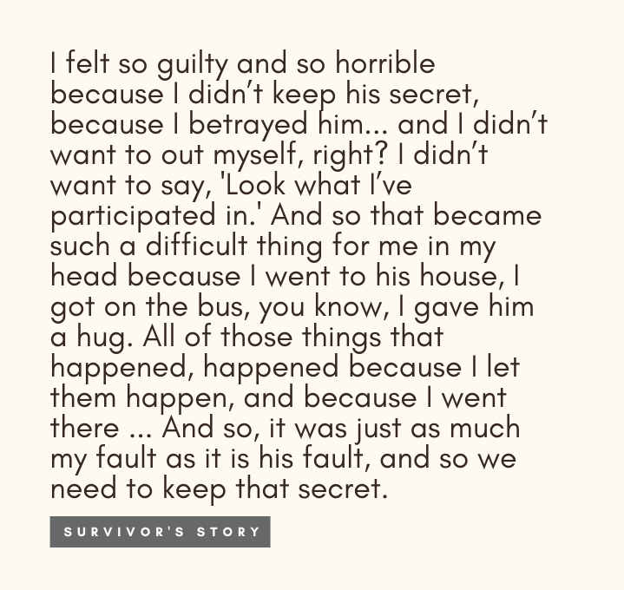
Why folks are hesitant to disclose
All survivors/victims do not become abusers
Family and friends may ‘look the other way’
This normalisation of the abuse can lead to children believing the abuse is their fault
35
Trauma Informed Care Workshop – April 5, 2023
Notes:
Note – covered in SAPP
Incest tends to be multi-generational; that is, people who were abused as children within their own family are at greater risk than others of becoming incest abusers themselves
This cycle of abuse is not inevitable. All victims do not become abusers
Family and friends may know about the abuse but cover it up or ‘look the other way.’ Acknowledging this truth can be so painful people can convince themselves it isn’t true.
This normalization of the abuse can lead to children believing the abuse is their fault.

Slide 36
Trauma Responses

Slide 37
Trauma Responses
Survivors can not predict how they will react when sharing and retelling their experiences. Memories and emotions may be triggered.
This can be the case throughout their every day, where seemingly unconnected events may trigger trauma responses.
37
Trauma Informed Care Workshop – April 5, 2023

Slide 38
Trauma Responses
Many of us have heard of these four trauma responses:
Fight: physical or verbal aggression
Flight: literal escape, like staying longer at school to avoid going home or running away altogether; or figuratively like putting all focus on studies; disassociating
Freeze: hypervigilance, watching others carefully, feeling on guard/alert; physically and/or mentally freezing
Fawn: people pleasing, attempts to pacify
38
Trauma Informed Care Workshop – April 5, 2023

Slide 39
Trauma Responses:
Sexual violence has physical and psychological, emotional and cognitive, impacts on a survivor. Examples of trauma responses include:
Depression, Post Traumatic Stress Disorder (PTSD), learning difficulties
Nightmares, trouble sleeping
Substance abuse, eating disorders, self-sabotage
Feelings of disempowerment, low self-esteem, impaired ability to trust
Feelings of stigmatization: feeling shamed, dirty, guilty, or bad
Economic impact
Impacts can expand to the survivor’s relationships
39
Trauma Informed Care Workshop – April 5, 2023
Notes:
Sexual violence has both physical and psychological impacts on a survivor.
Examples such as:
Depression, PTSD
Nightmares, trouble sleeping
substance abuse, eating disorders, self-sabotage
Feelings of disempowerment, low self-esteem, impaired ability to trust
Feelings of stigmatization: feeling shamed, dirty, guilty, or bad
These impacts can expand to the survivor’s relationships (romantic, friendships, families, future generations) and may even have an economic impact as families may need leave work and/or pay legal bills and/or for mental healthcare.
References: At the Time of Disclosure a Manual for Front-Line Community Workers Dealing with Sexual Abuse Disclosures in Aboriginal Communities,
www.publicsafety.gc.ca/cnt/rsrcs/pblctns/tm-dsclsr-mnl/index-en.aspx

Slide 40
Trauma Responses: Reaction response
Try to anticipate and prepare for likely responses to the disclosure of abuse by the survivor’s family, abuser, those closest to the situation, and the survivor themselves
Living with experiences of sexual violence and going through various systems and processes can be exhausting, retraumatizing, and even embarrassing. Survivors may be labelled as lazy, aggressive, or anti-social, or may come to class, work, and/or programs late due to various appointments.
Compassion, understanding, and empathy, is needed when recognizing and responding to trauma responses.
40
Trauma Informed Care Workshop – April 5, 2023
Notes:
Try to anticipate and prepare for likely responses to the disclosure of abuse (while remaining open to other possible responses) by the survivor’s family, abuser, those closest to the situation, and the survivor themselves – removed this, as it’s not just about reactions related to disclosures
Living with experiences of sexual violence and going through various systems and processes can be exhausting, retraumatizing, and even embarrassing. Children may be labelled as lazy, aggressive, or anti-social, or may come to class and/or programs late due to various appointments. (Could we maybe add an example of how this would affect adults instead? E.g., Labelled as lazy, self-destructive, unreliable)
Compassion, understanding, and empathy, is needed when recognizing and responding to trauma responses.
References: At the Time of Disclosure a Manual for Front-Line Community Workers Dealing
with Sexual Abuse Disclosures in Aboriginal Communities, www.publicsafety.gc.ca/cnt/rsrcs/pblctns/tm-dsclsr-mnl/index-en.aspx

Slide 41
Processing Triggers & Self-Care

Slide 42
Processing Triggers
When faced with someone’s response to a traumatic event, our own emotions and experiences may be triggered.
Some things may be a trigger that we didn’t consider before.
We may not know how we will react and feel to disclosures of sexual violence.
42
Trauma Informed Care Workshop – April 5, 2023
Notes:
When receiving disclosures faced with someone’s response to a traumatic event, our own emotions and experiences may be triggered – removed focus on just disclosures.
Some things may be a trigger that we didn’t consider before.
We may not know how we will react and feel to disclosures of sexual violence.

Slide 43
Processing Triggers: Vicarious trauma
The British Medical Association provides a list of signs of vicarious trauma:
experiencing lingering feelings of anger, rage and sadness about a [survivor’s] victimization
becoming overly involved emotionally with the [survivor]
experiencing bystander guilt, shame, feelings of self-doubt
being preoccupied with thoughts of [the survivor] outside of the work situation
over identification with the [survivor]
loss of hope, pessimism, cynicism
distancing, numbing, detachment, staying busy.
avoiding listening to story of traumatic experiences
difficulty in maintaining professional boundaries
43
Trauma Informed Care Workshop – April 5, 2023
Notes:
The British Medical Association provides a list of signs of vicarious trauma:
experiencing lingering feelings of anger, rage and sadness about patient’s victimization
becoming overly involved emotionally with the [survivor]
experiencing bystander guilt, shame, feelings of self-doubt
being preoccupied with thoughts of [the survivor] outside of the work situation
over identification with the patient (having horror and rescue fantasies)
loss of hope, pessimism, cynicism
distancing, numbing, detachment, cutting patients off, staying busy. Avoiding listening to client's story of traumatic experiences
difficulty in maintaining professional boundaries
References: Vicarious trauma: signs and strategies for coping, British Medical Association, www.bma.org.uk/advice-and-support/your-wellbeing/vicarious-trauma/vicarious-trauma-signs-and-strategies-for-coping

Slide 44
Processing Triggers: Recognizing your own triggers
Check in with yourself, are there certain experiences that may cause a trigger reaction within yourself?
Are you able to recognize the physical signs you may experience when triggered?
44
Trauma Informed Care Workshop – April 5, 2023
Notes:
Check in on yourself, are there certain experiences that may cause a trigger reaction within yourself?
Are you able to recognize the physical signs you may experience when triggered?

Slide 45
Processing Triggers: Self-care
Self-care is a term that has been commodified, but, if we reclaim it as a practice that can be unique to each of us, it is something worth prioritizing.
What does self-care look like to you?
What does your support system look like?
Your emotions and reactions are valid, and you are allowed to process them how you see fit for you at the time.
Try to find balance between your needs and the needs of others.
45
Trauma Informed Care Workshop – April 5, 2023
Notes:
Self-care is a term that has been commodified, however, if we reclaim it as a practice that can be unique to each of us, it is something worth prioritizing.
What does self-care look like to you? Is it a nice long bath, is it getting a pesky chore off the to-do list, is it seeing a movie with friends?
What does your support system look like? Are there people you can check in with, do you have a regularly scheduled call with a close friend or family member where there is space to debrief if you choose, and/or maybe you have your own counselling set up.
Your emotions and reactions are valid and you are allowed to process them how you see fit for you at the time.
Try to find balance between your needs and the needs of others.

Slide 46
Caring for Self and Others This is a difficult subject for everyone – but it is important
As an employer, you know your team and can encourage RECEs to work through and complete the program together.
Engaging in reflection and dialogue with staff and colleagues in your network can enhance learning and provide additional support.
Consider checking in with your staff as they engage or re-engage with the content.
Consider options for RECEs who may not want to complete the program as a group.
If a staff is in need of professional support, having resources you can share with them.
46
Trauma Informed Care Workshop – April 5, 2023
Notes:
As a caring professional, you work closely with children and their families. Because of these close relationships you hold a unique position of trust. Although the Sexual Abuse Prevention Program is designed with a focus on prevention, engaging with its content can be emotionally, mentally and physically distressing. For some, this content can be particularly difficult due to lived experience related to abuse, including, but not limited to sexual abuse or violence.
If you are finding it difficult to engage with the content due to past or recent experiences, you are not alone. Whether a traumatic event(s) happened as a child, youth or adult, all can be devastating. Being exposed to certain events, people or information can cause a stored memory to resurface. Being able to understand what is happening for you, and learning about why you have certain responses can help you…. Bullet points on slide

Slide 47
Caring for Self and Others Strategies for supporting staff
Some strategies to share with staff while they complete the prevention program could be, completing the program:
alone, in groups, or with a trusted person
in multiple sessions instead of all at once
without listening to the testimonials in the C3P Commit to Kids modules, which are not required for completion
with a plan of who they can reach out to in the event they experience distress – a trusted friend or family member, or crisis centre
47
Trauma Informed Care Workshop – April 5, 2023
Notes:
For some ways to care for yourself before starting the program consider the following strategies below. For example, you may complete the program:
alone, in groups, or with a trusted person
in multiple sessions instead of all at once
without listening to the testimonials in the C3P Commit to Kids modules, which are not required for completion
with a plan of who you can reach out to in the event you experience distress – a trusted friend or family member, or crisis centre
Check in with yourself regularly. Recognizing how you are feeling isn’t something you may do every day or be comfortable doing but being aware of how you are feeling is an important part of self-care

Slide 48
OCRCC – Contact Us
Directory of Ontario Sexual Assault Centres: sexualassaultsupport.ca/support
Bystander Intervention resources: draw-the-line.ca
OCRCC social media
Facebook: @OntarioCoalitionofRapeCrisisCentres
Twitter and Instagram: @OCRCC_ON
Draw the Line social media
Facebook: @WhereDrawtheLine
Twitter and Instagram: @drawthelineon
48
Trauma Informed Care Workshop – April 5, 2023

Slide 49
Q+A
49
Trauma Informed Care Workshop – April 5, 2023
Notes:
Survey + end of workshop housekeeping
● As we head into the discussion period:
● Please take a moment to fill out our survey to help us develop future content
and to keep these important conversations going. The link will disappear with
the chat after we wrap up, so I always suggest opening it in a new browser.
● Reminder that we have a counsellor available

Slide 50
Thank You
sexualassaultsupport.ca | college-ece.ca

